Slide 1

18ECC303J – Computer Communication Networks
Course Credit : 4
Theory : 9 Hours
Reference Text Books
1.Behrouz A. Fehrouzan, “Data communication & Networking”, Mc-Graw Hill, 5th Edition Reprint, 2014.
2. Andrew S. Tanenbaum, “Computer Networks”, Pearson Education India, 5th Edition, 2013.
3. William Stallings, “Data & Computer Communication”, Pearson Education India, 10th Edition, 2014.

Slide 2
Unit 3 – Network Layer
Session 1
Introduction to Network Layer
Need for Internetworking
Session 2
Addressing-Classful
Session 3
Addressing-Classless
Session 6
Network Layer Protocol-IPV4
Session 7
Internet Protocol(IP)-IPV6
Session 8
Session 11
Routing Protocols- Distance Vector& Link State
Routing Issues-Delivery, Forwarding and Routing
Routing Information Protocol-RIP
Session 12
Open Shortest Path First-OSPF
Session 13
Border Gateway Protocol-BGP
Week 7
Week 8
Week 9

Slide 3

Objectives
Upon completion you will be able to:
Recall the Fundamentals of Network layer, its services
Understand the concept of Internetworking and its need
Understand IPv4 addresses and classes
Identify the class of an IP address
Find the network address given an IP address
Understand masks and how to use them
Understand subnets and supernets

Slide 4
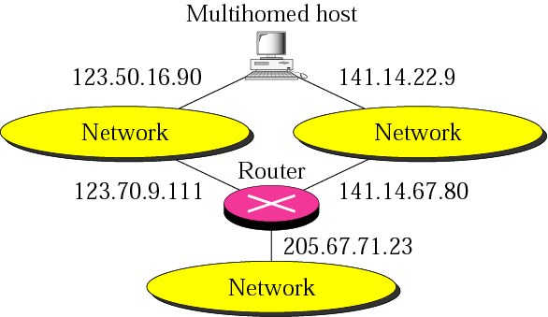
Others Issues
Multihomed devices (computers, or routers)
A computer that is connected to different networks
Having more than one address

Slide 5
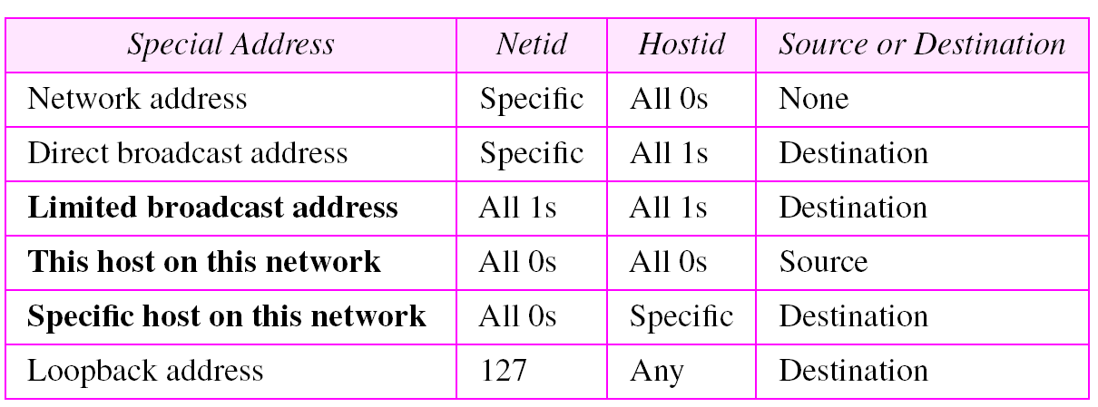
Special Addresses
Some parts of the address space in class A, B, C for special addresses
Special addresses

Slide 6
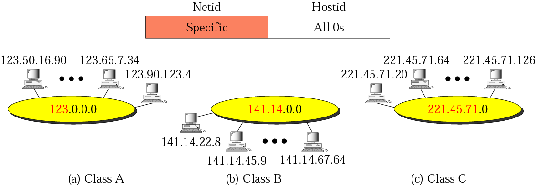
Special Addresses
Network address : an address with the hostid all set to 0s

Slide 7
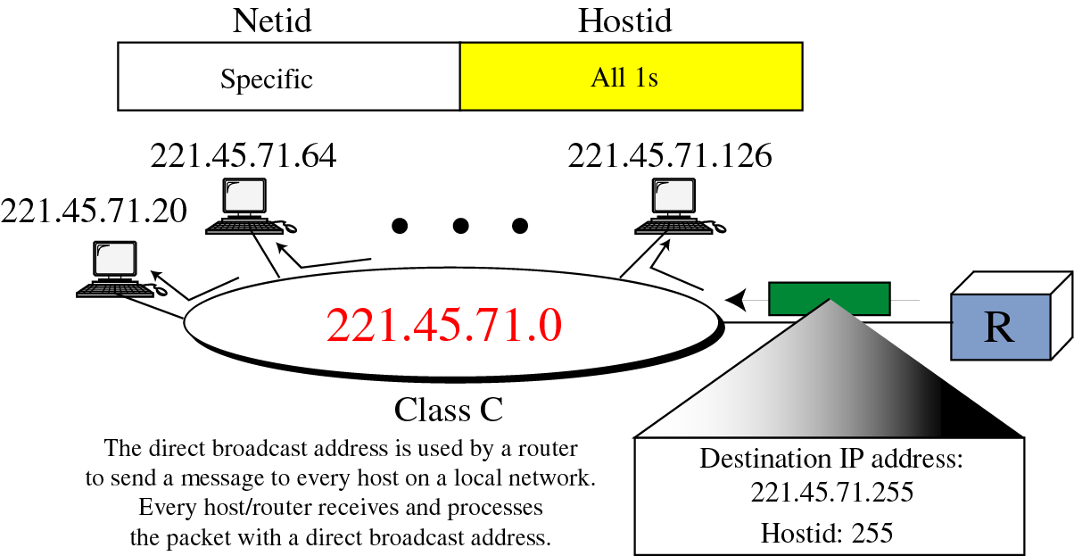
Special Addresses (cont’d)
Direct Broadcast Address : Used by a router to send a packet to all hosts in a specific network

Slide 8
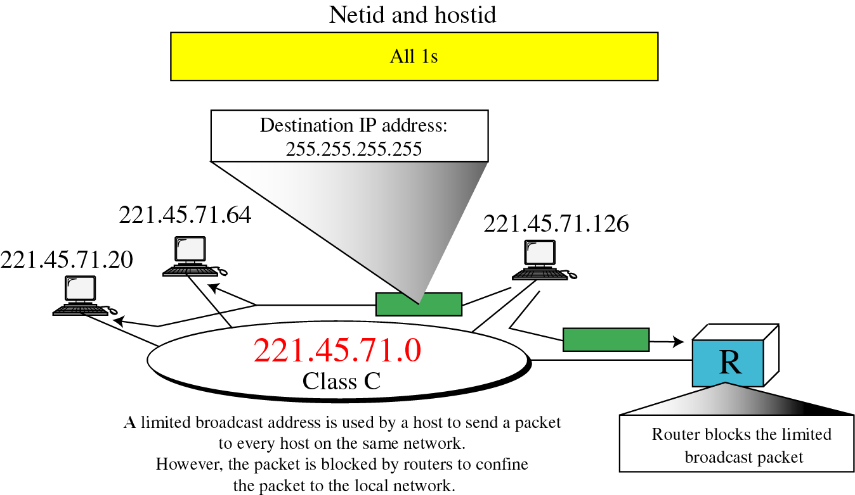
Special Addresses (cont’d)
Limited Broadcast Address : all 1s for the netid and hostid (32bits)

Slide 9
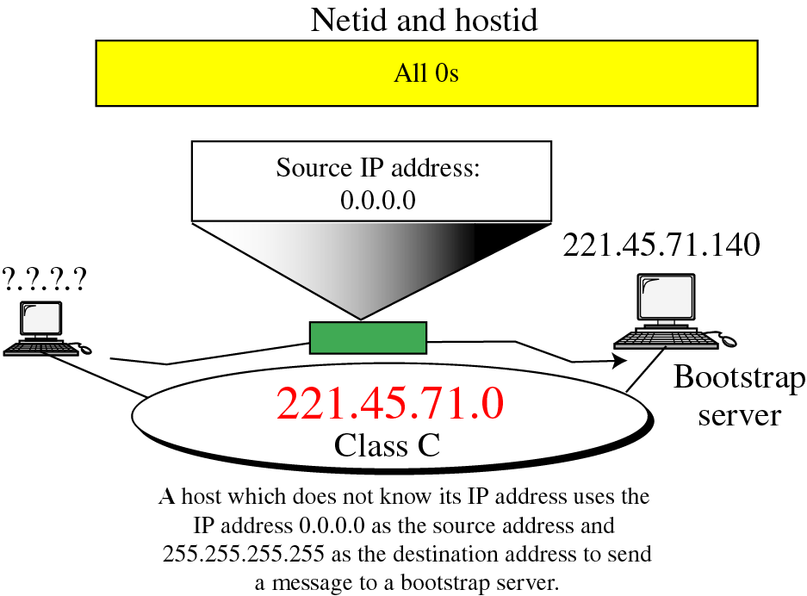
Special Addresses (cont’d)
This Host on This Network : used by a host at bootstrap time when it does not know its IP address

Slide 10
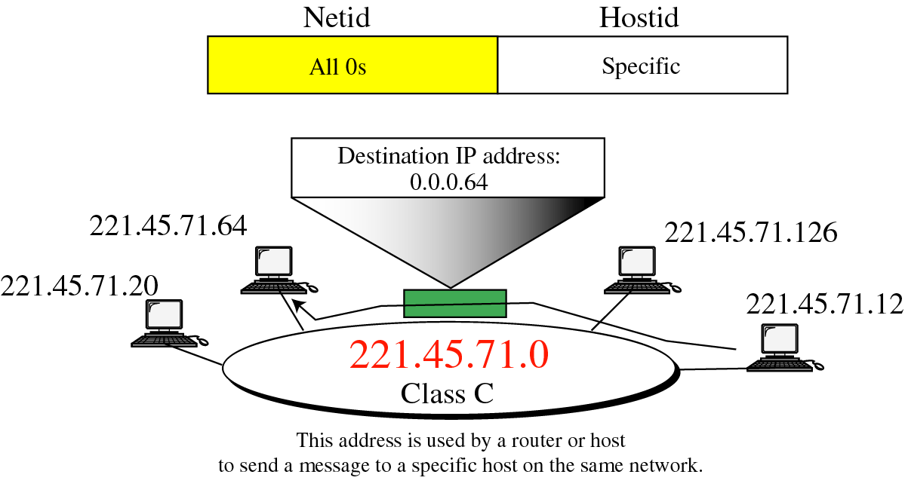
Special Addresses (cont’d)
Specific Host on This Network : used by a host to send a message to another on the same network

Slide 11
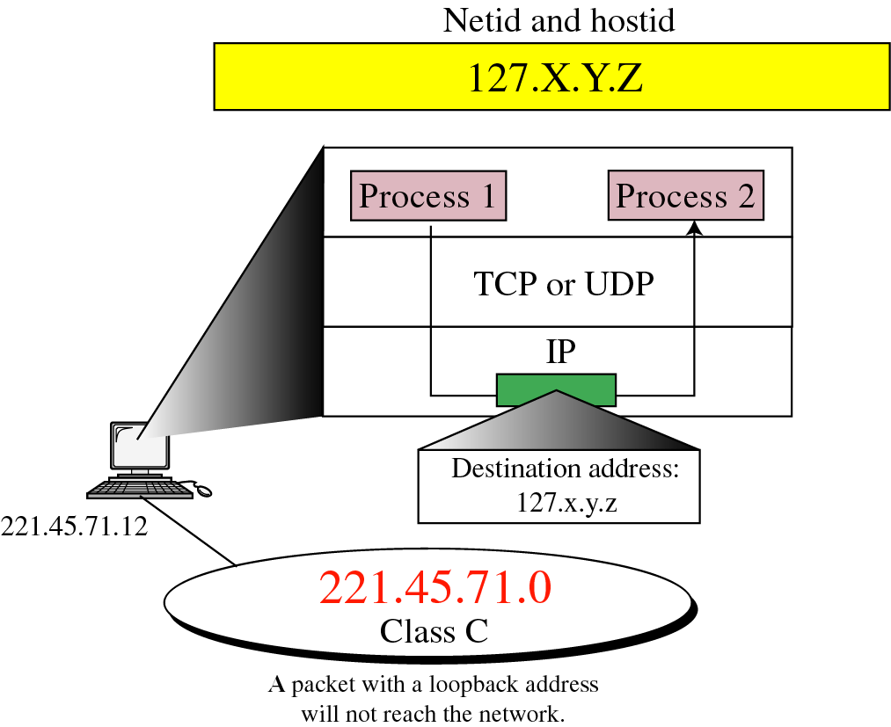
Special Addresses (cont’d)
Loopback Address :
IP address of the first byte : 127
Used to test the software on a machine
Used by a client process to send a message to a server process on the same machine
“Ping”

Slide 12
Private Addresses
A number of blocks in each class are assigned for private use. They are not recognized globally. Useful for intranets with more devices. (Translation tables – NAT router for smaller set external address mapping)
Class Netid Total Blocks Addresses
Class A 10.0.0.0 to 255.255.255 1 2^24
Class B 172.16 to 172.31 16 2^20
Class C 192.68.0 to 192.68.255 256 2^16

Slide 13
Unicast, Multicast, and Broadcast Addresses
Unicast communication.
Multicast communication.
Broadcast communication.
Broadcast addresses : one-to-all
Allowed only at the local level
Limited broadcast address (all 1s)
Direct broadcast address (netid: specific, hostid: all 0s)
No broadcasting is allowed at the global level
Unicast Addresses : one-to-one
Multicast addresses : one-to-many; class D address
Used as a destination address

Slide 14
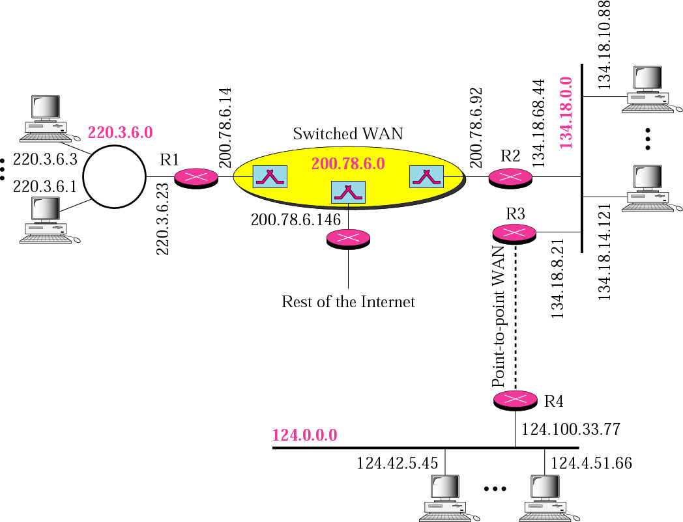
A Sample Internet with Classful Address
Token Ring LAN (Class C), Ethernet LAN (Class B), Ethernet LAN (Class A) , Point-to-point WAN, A Switched WAN

Slide 15
Subnetting and Supernetting
Subnetting
A network is divided into several smaller networks with each subnetwork (or subnet) having its subnetwork address
Supernetting
Combining several class C addresses to create a larger range of addresses
IP Addresses are designed with two levels of hierarchy

Slide 16
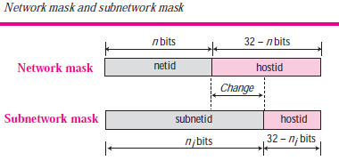
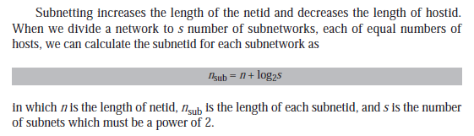

Slide 17
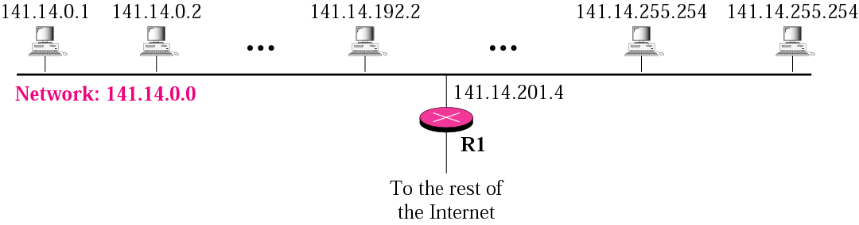
Subnetting
Classes A, B, C in IP addressing are designed with two levels of hierarchy (not subnetted) :Netid and Hostid
This network (141.14.0.0) is a class B and can have 2^16 hosts.
There is only 1 network with a whole-lotta hosts!

Slide 18
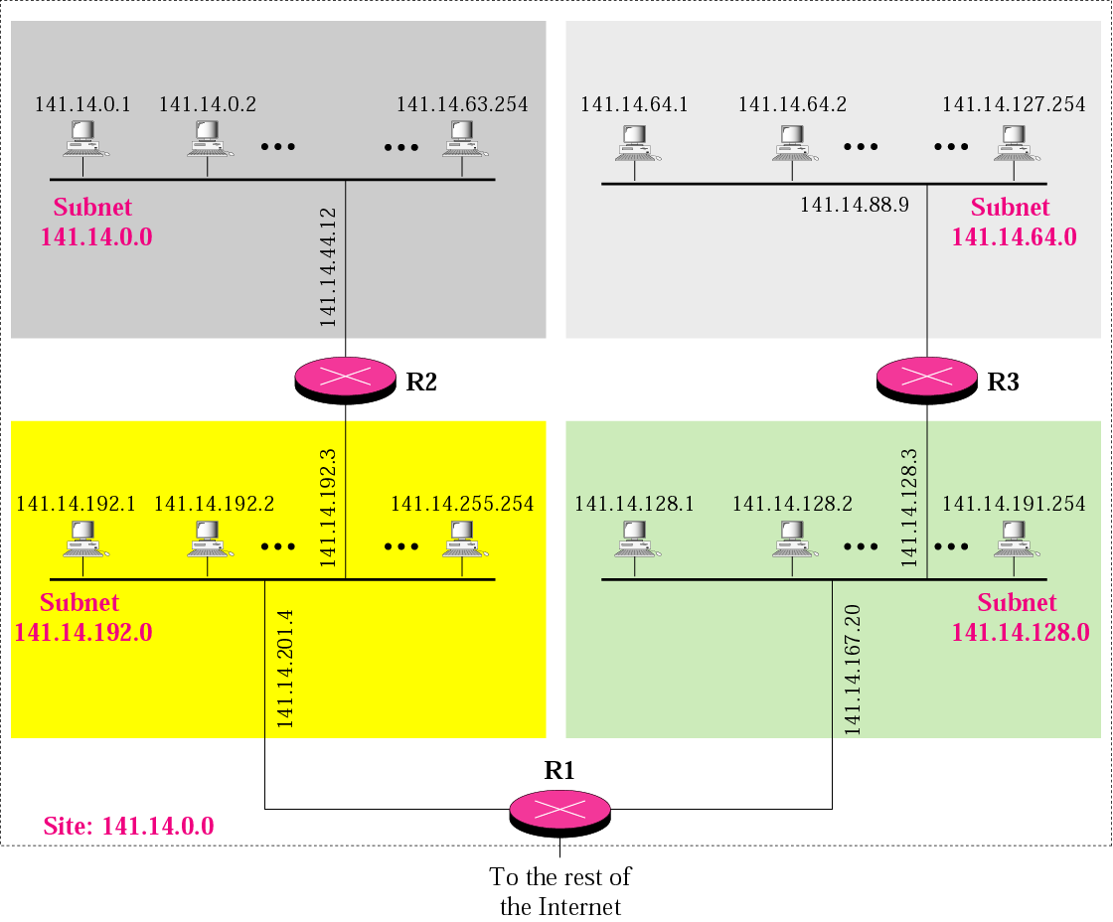
Subnetting (cont’d)
Further division of a network into smaller networks called subnetworks

Slide 19
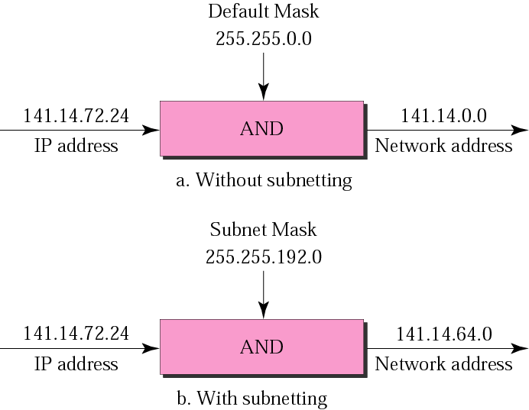
Default mask and Subnet Mask
A process that extracts the address of the physical network (network/subnetwork portion) from an IP address

Slide 20
Finding the Subnetwork address
Given an IP address, we can find the subnet address by applying the mask to the IP address. Use binary notation for both the address and the mask and then apply the AND operation to find the subnet address.
Example
What is the subnetwork address if the destination address is 132.45.34.56 and the subnet mask is 255.255.240.0?
Solution:
The subnetwork address is 132.45.32.0 (3rd subnet out 16 subnets in 132.45.0.0). The last address in this subnet is 132.45.47.255. How? Just complement subnet mask and then ORed with any one of the address in this subnet. Try!
Address ➡ 10000100 00101101 00100010 00111000
Subnet Mask ➡ 11111111 11111111 11110000 00000000
Subnetwork Address ➡ 10000100 00101101 00100000 00000000.

Slide 21
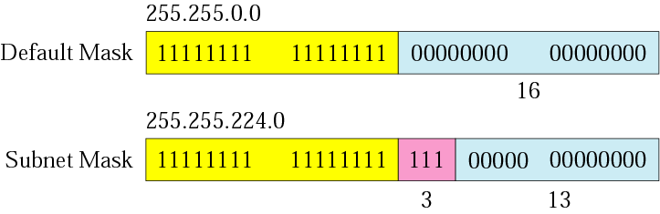
Comparison of a default mask and a subnet mask
With this subnet mask, you have 3 bits for the subnet address (the pink portion) which equals 8 addresses( i.e. 8 subnets), leaving 13 bits for the Hostid (the blue portion) which equals 2^13 hosts.

Slide 22
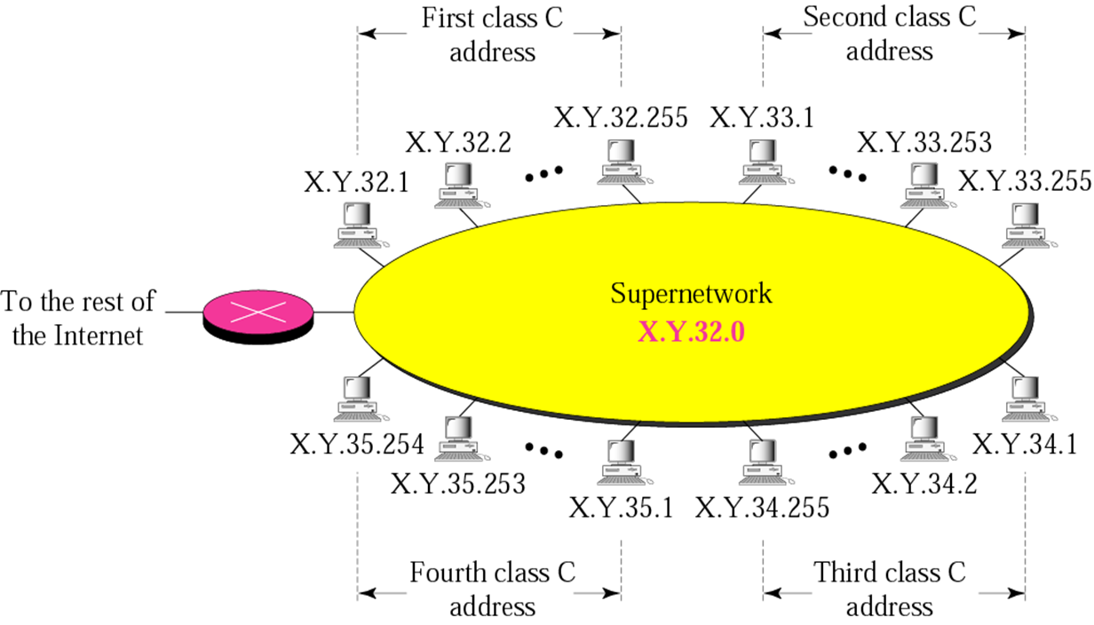
Supernetwork
A block of class x addresses
For example,
An organization that needs 1,000 addresses can be granted four class C addresses.
4 class C addresses combine to make one supernetwork.
X.Y.35.255 (last address) is a direct broadcast ID.
Supernet ID (first address) is X.Y.32.0
Supernet Mask is 255.255.252.0, ie.,
11111111 11111111 11111100 00000000

Slide 23

Supernetting (cont’d)
4 class C addresses combine to make one supernetwork

Slide 24

In subnetting, we need the first address of the subnet and the subnet mask to define the range of addresses.
In supernetting, we need the first address of the supernet and the supernet mask to define the range of addresses.

Slide 25
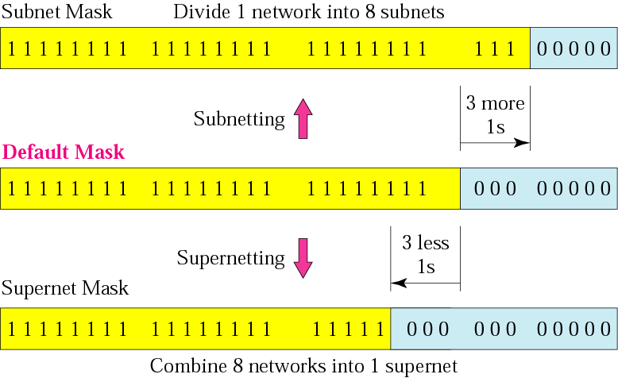
Comparison of Subnet, Default and Supernet Mask

Slide 26
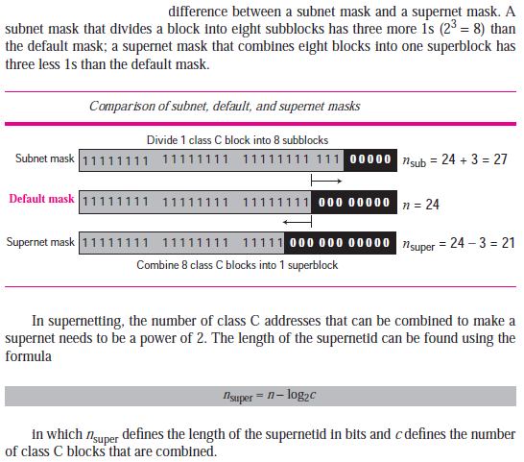

Slide 27
Summary
At the Network layer, a global identification system that uniquely identifies every host and router is necessary for delivery of packet from host to host.
An IPv4 address is 32 bits long and uniquely and universally defines a host or router on the Internet.
The portion of the IP address that identifies the net is called the netid.
The portion of the IP address that identifies the host or router on the network is called the hostid.
An IP address defines a device’s connection to a network.
There are five classes in IPv4 addresses. Classes A, B, and C differ in the number of hosts allowed per network. Class D is for multicasting and Class E is reserved.

Slide 28
Summary
The class of an address is easily determined by examination of the first byte.
Addresses in classes A, B, or C are mostly used for unicast communication.
Address in class D are used for multicast communication.
Subnetting divides on large network into several smaller ones, adding an intermediate level of hierarchy in IP addressing.\
Classes A, B and C addresses can be subnetted.
Supernetting combines several networks into one large one.

Slide 29
Disadvantage of Classful Address:
millions of Class A and Class B address are wasted
number of addresses available in class C is so small that it cannot cater the needs of organizations
Maintenance is time consuming
More prone to errors
Security issues

Slide 30

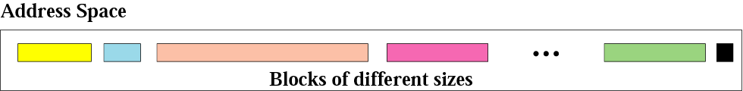
Session - 3
Classless Addressing provides a method to generate any range of IP address blocks, serving user requirements.
Unlike Classful Addressing, Classless Addressing does not divide address space into fixed parts
The whole idea of classless addressing is divided into variable-length blocks that belong to no class.
Number of Addresses in a Block must be a power of 2
Variable-length blocks
The Classless Inter-Domain Routing, in short CIDR, is a method that is adopted to distribute and allocate blocks of IP addresses and further assist in IP routing.
The CIDR was first introduced in 1993 by the Internet Engineering Task Force to replace the previous Classful addressing scheme on the Internet.

Slide 31
Advantages of classless addressing over classful addressing:
Overcomes address depletion and give more organizations access to the Internet
Classful addressing does not send subnet information.
Efficient address-space allocation is available in classless addressing.
Memory is allocated in terms of bits and bytes rather than huge chunks of contiguous memory.
It eliminates any class imbalances.

Slide 32
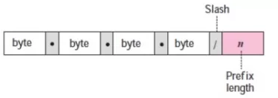

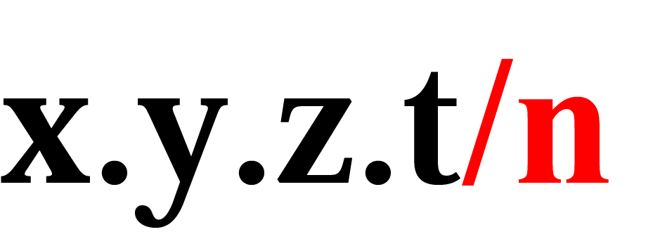
Classless Addressing
Two level addressing:
Here the prefix defines the network and suffix defines the host.
Length of prefix depends on the size of block and not fixed , it can be 1 to 32.
Prefix length is given by n
Suffix length is given by 32-n
Here, in a network, the value of “Prefix” will be the same, but the value of “Suffix” will vary with the number of hosts.
So, the length of Prefix (n) can have value as 1,2, 3,4….,31, and the Suffix value automatically calculated as 32 – length of Prefix (n).
In Classless Addressing, we can always have the length of the Prefix(n) of the IP address. You can find at the end of the IP address with a slash (/n).
This slash notation in Classless Addressing is formally known as Classless Inter-Domain Routing (CIDR) notation.
The n after the slash defines the number of bits that are the same in the every address in the block
For instance, if the IPv4 address is in CIDR notation like 192.168.170.82/27, then 27 is the length of Prefix that is the number of bits allocated to the network ID. Also, the suffix length we can calculate as 32-27 = 5.

Slide 33
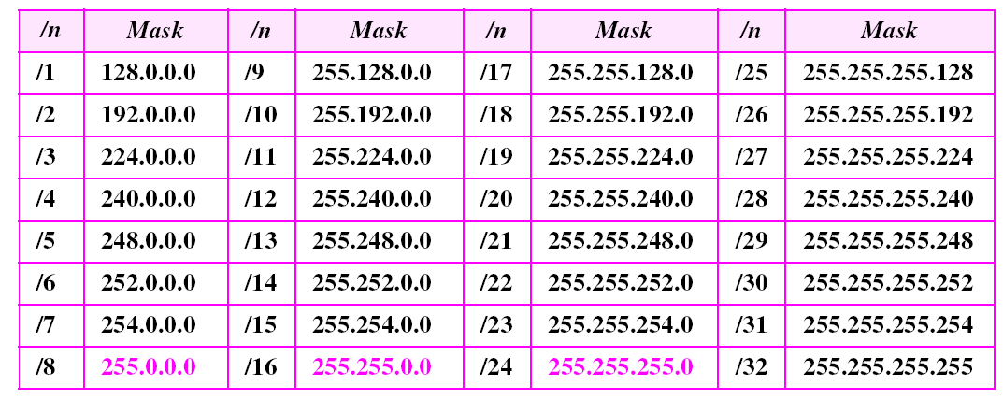
Prefix and Prefix Length
Similar to netid
Table : Prefix lengths

Slide 34
Classless Addressing
CIDR tries to balance the desire to minimize the number of routes that a router needs to know against the need to hand out addresses efficiently.
CIDR uses aggregate routes
Uses a single entry in the forwarding table to tell the router how to reach a lot of different networks
Breaks the rigid boundaries (of classful addressing) between address classes
The implementation of the CIDR block in Classless Addressing is achieved with three rules.
The allocated block of IP address must have a contiguous unallocated address.
The number of IP addresses given to the customer must be in the power of 2.
The first address of the address blocks must be evenly divisible by the length of the block.

Slide 35

Classless Addressing
Extracting Block information
Number of addresses
First address
Last address
The number of host address from the given block of address is calculated as
where N is the number of host addresses, and n is the length of the Prefix.
The first address of the block
First address = (given address) AND (network mask)
The last address of the block
Last address = (given address) Or [NOT (network address)]
Example
What is the first address in the block if one of the addresses is 167.199.170.82/27?
Solution
The prefix length is 27, which means that we must keep the first 27 bits as it is and change the remaining bits (5) to 0s.
The following shows the process:
Address in binary: 10100111 11000111 10101010 01010010
Keep the left 27 bits:10100111 11000111 10101010 01000000
Result in CIDR notation: 167.199.170.64/27

Slide 36
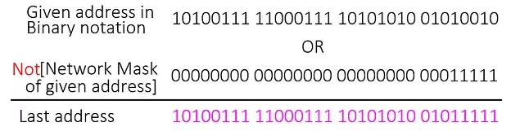
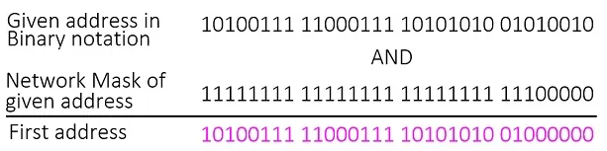
Classless Addressing
Example (to find first address and last address)
IP address 167.199.170.82/27, which is in CIDR notation and belongs to a Classless address.
Here, the length of the Prefix (n) = 27
So, using the above formula, the number host (N) = 2^32-27 = 2^5 = 32.
To calculate the first address of the IP address block, we can use the below formula:
First address = (given address) AND (network mask)
The given IP address is 167.199.170.82
When we convert into a binary number, the whole thing will look as below
.
Given address in binary notation = 10100111 11000111 10101010 01010010
Network mask of given address = 11111111 11111111 11111111 11100000
Here, we will use the AND operator to get the result. For the AND operator,
So, 1 AND 1 = 1, 1 AND 0 = 0 and 0 AND 0 = 0
The result for the First address would be 10100111 11000111 10101010 01000000
The decimal notation of the First address would be 167.199. 170.64
Similarly, the Last address we can calculate as below.
The given address in binary notation = 10100111 11000111 10101010 01010010
The Not(Network Mask given address) = 00000000 00000000 00000000 00011111
So, the Last address = (given address) OR [Not(Network Mask from given address)]
Here, the NOT operator will change the value just opposite (True to False and False to True), whereas the OR operator follows the addition rule.
So, 0 OR 1 = 1, 1 OR 1 = 1 and 0 OR 0 = 0.
Now, the Last address would be 10100111 11000111 10101010 01011111
The decimal notation of the Last address would be 167.199.170.95.
From the above example, we have concluded that
167.199.170.82 is the given address,
167.199.170.64 is the First address, and
167.199.170.95 is the Last address.
The total number of hosts is 32.

Slide 37
Network address
A very important concept in IP addressing is the network address.
When an organization is given a block of addresses, the organization is free to allocate the addresses to the devices that need to be connected to the Internet.
The first address is called the network address and defines the organization network. First address is the one that is used by routers to direct the message sent to the organization from the outside.
The first address in a block is normally not assigned to any device; it is used as the network address that represents the organization to the rest of the world.
The organization network is connected to the Internet via a router. The router has
two addresses. One belongs to the granted block; the other belongs to the network that is at the other side of the router. We call the second address x.y.z.t/n because we do not know anything about the network it is connected to at the other side. All messages destined for addresses in the organization block (205.16.37.32 to 205.16.37.47) are sent, directly or indirectly, to x.y.z.t/n.

Slide 38
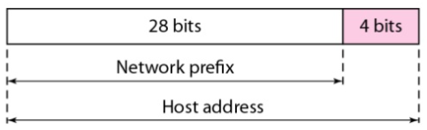
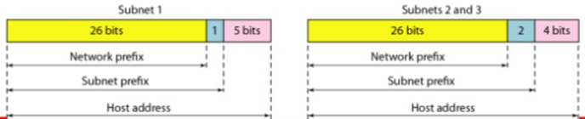
Hierarchy: IP addresses, like other addresses or identifiers we encounter these days, have levels of hierarchy.
Two level Hierarchy
Three level Hierarchy
An IP address can define only two levels of hierarchy when not subnetted.
The n leftmost bits of the address x.y.z.t/n define the network (organization network);
the 32 – n rightmost bits define the particular host (computer or router) to the network.
The two common terms are prefix and suffix.
The part of the address that defines the network is called the prefix; the part that defines the host is called the suffix.
The prefix is common to all addresses in the network; the suffix changes from one device to another.
Through subnetting, we have three levels of hierarchy. Note that , the subnet prefix length can differ for the subnets .
The structure of classless addressing does not restrict the number of hierarchical levels.
An organization can divide the granted block of addresses into subblocks.
Each subblock can in turn be divided into smaller subblocks. And so on.
One example of this is seen in the ISPs. A national ISP can divide a granted large block into smaller blocks and assign each of them to a regional ISP. A regional ISP can divide the block received from the national ISP into smaller blocks and assign each one to a local ISP. A local ISP can divide the block received(for customers)

Slide 39
Address Allocation
The next issue in classless addressing is address allocation
Address allocation is the responsibility of a global authority called the Internet Corporation for Assigned Names and Numbers (ICANN).
It usually assigns a large block of addresses to an ISP to be distributed to its Internet users. which in turn, grant small subblocks to individual customers. This is called address aggregation: many blocks of addresses are aggregated in one block and granted to one ISP.

Slide 40
Summary
In classless addressing, we can divide the address space into variable-length blocks.
There are three restrictions in classless addressing:
The number of addresses needs to be a power of 2.
The mask needs to be included in the address to define the block.
The stating address must be divisible by the number of addresses in the block.
The mask in classless addressing is expressed as the prefix length (/n) in CIDR notation.
To find the first address in a block, we need to apply the mask to one of the addresses.
To find the number of addresses in the block, we calculate 2^{32-n}, where n is the prefix length.
To find the last address in the block, we add the first address to the number of addresses and subtract one.
We can have both fixed-length and variable-length subnetting. In fixed-length subnetting, the number of addresses in each subnet is the same. In variable-length subnetting, the number of addresses in each subnet can be different.
In fixed-length subnetting, the number of subnets needs to be a power of 2. There is no such restriction in variable-length subnetting.
Subnetting increases the value of n.
The global authority for address allocation is ICANN. ICANN normally grants large blocks of addresses to ISPs, which in turn, grant small subblocks to individual customers.

